Slide 1
SQL PREPARATION
Manjyanaik V D
Data Analyst
TOPIC:
INNER JOIN

Slide 2
Definition:
An INNER JOIN is a type of SQL (Structured Query Language) operation used in relational database management systems.
It is employed to combine rows from two or more tables based on a related column between them.
The result of an INNER JOIN includes only the rows that have matching values in both tables, excluding rows where there is no match.

Slide 3
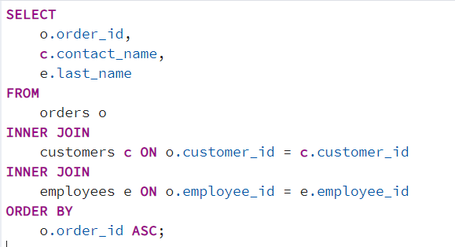
1.Write a query to get order_id, contact_name and last_name

Slide 4
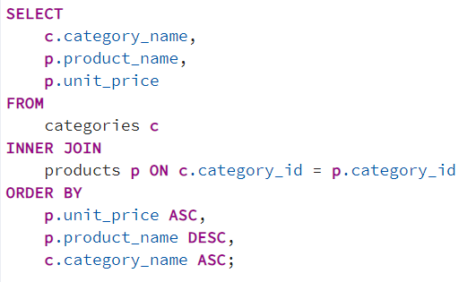
2.Return a list of products and their category names. Include product_name and unit price columns from the Products table and only the category name column from the Categories table.

Slide 5
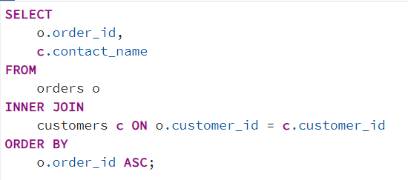
3. Using orders and customer table, get the contact name of the customer against every order_id in the orders table

Slide 6
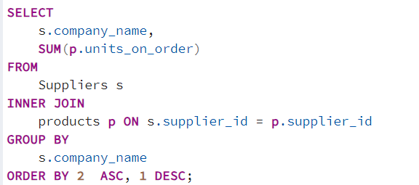
4.Calculate company_name wise total units_on_order.

Slide 7
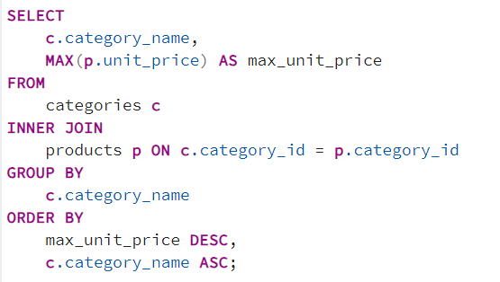
5.get the price of the most expensive item in each category_name.

